Slide 1
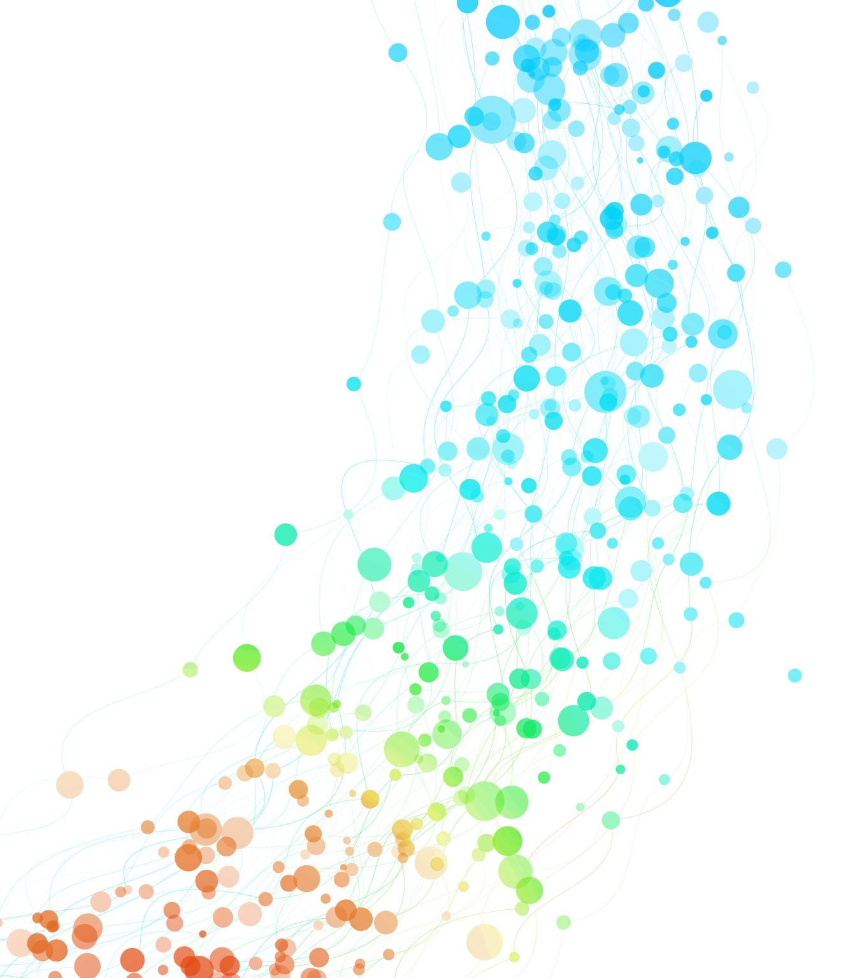
Templates and URLs

Slide 2
What is a 404 error
A 404 error may occur if
The URL or its content (such as files or images) was either deleted or moved (without adjusting any internal links accordingly)
The URL was written incorrectly (during the creation process or a redesign), linked incorrectly, or typed into the browser incorrectly
The server responsible for the website is not running or the connection is broken
The requested domain name can’t be converted to an IP by the domain name system (DNS)
The entered domain name doesn’t exist (anymore)
https://www.ionos.co.uk/digitalguide/websites/website-creation/what-does-the-404-not-found-error-mean/

Slide 3
Raising a 404 error
Change the details method in views.py to handle an exception in case a question is not found
def detail(request, question_id): try: question = Question.objects.get(pk=question_id) except Question.DoesNotExist: raise Http404("Question does not exist") return render(request, "polls/detail.html", {"question": question})

Slide 4
A shortcut: get_object_or_404()
def detail(request, question_id): question = get_object_or_404(Question, pk=question_id) return render(request, "polls/detail.html", {"question": question})

Slide 5
Templates
A template contains the static parts of the desired HTML output as well as some special syntax describing how dynamic content will be inserted
Django ships built-in backends for its own template system, creatively called the Django template language (DTL)
A Django template is a text document or a Python string marked-up using the Django template language.
A template is rendered with a context. Rendering replaces variables with their values, which are looked up in the context, and executes tags.
The rest of the content remains as is

Slide 6
Template render process
Render Data
Template
Render Engine
Rendered Output

Slide 7
Template render process
<<context>>
<h1>Data</h1>
<pre>
{{ data }}
</pre>
{ ‘data' : ‘100' }
Render Engine
<h1>Data</h1>
<pre>
100
</pre>

Slide 8
The four constructs of Django Template Language
Variables:
A variable outputs a value from the context, which is a dictionary-like object mapping keys to values.
Variables are surrounded by {{ and }}
My first name is {{ first_name }}. My last name is {{ last_name }}.
With a context of {'first_name': 'John', 'last_name': 'Doe'}, this template renders to:
My first name is John. My last name is Doe.
Dictionary lookup, attribute lookup and list-index lookups are implemented with a dot notation:
{{ my_dict.key }}
{{ my_object.attribute }}
{{ my_list.0 }}
https://docs.djangoproject.com/en/5.0/topics/templates/

Slide 9
The four constructs of Django Template Language
Tag:
Tags provide arbitrary logic in the rendering process.
This definition is deliberately vague. For example, a tag can output content, serve as a control structure e.g. an “if” statement or a “for” loop, grab content from a database, or even enable access to other template tags.
Tags are surrounded by {% and %}
{% csrf_token %}
{% cycle 'odd' 'even' %}
{% if user.is_authenticated %}Hello, {{ user.username }}.{% endif %}
{% for athlete in athlete_list %}
<li>{{ athlete.name }}</li>
{% endfor %}
https://docs.djangoproject.com/en/5.0/topics/templates/

Slide 10
The four constructs of Django Template Language
Filters:
Filters transform the values of variables and tag arguments.
They look like this:
{{ django|title }}
With a context of {'django': 'the web framework for perfectionists with deadlines'}, this template renders to:
The Web Framework For Perfectionists With Deadlines
Some filters take an argument:
{{ my_date|date:"Y-m-d" }}
https://docs.djangoproject.com/en/5.0/topics/templates/

Slide 11
The four constructs of Django Template Language
Comments:
Comments look like this:
{# this won't be rendered #}
A {% comment %} tag provides multi-line comments.
<p>Rendered text with {{ pub_date|date:"c" }}</p>
{% comment "Optional note" %}
<p>Commented out text with {{ create_date|date:"c" }}</p>
{% endcomment %}
https://docs.djangoproject.com/en/5.0/topics/templates/

Slide 12
A Sample Template
Here’s what the polls/detail.html template might look like:
<h1>{{ question.question_text }}</h1> <ul> {% for choice in question.choice_set.all %} <li>{{ choice.choice_text }}</li> {% endfor %} </ul>

Slide 13
Avoiding Hardcoded Templates
The link in the polls/index.html template, was partially hardcoded:
<li><a href="/polls/{{ question.id }}/">{{ question.question_text }}</a></li>
You can remove a reliance on specific URL paths defined in your url configurations by using the {% url %} template tag:
<li><a href="{% url 'detail' question.id %}">{{ question.question_text }}</a></li>
The URL definition as specified in the polls.urls module with the URL name being ‘detail’ as defined below:
# the 'name' value as called by the {% url %} template tag path("<int:question_id>/", views.detail, name="detail"),

Slide 14
Namespacing URL names
In big Django projects there may be many apps and several may have detail views, therefore you can differentiate between the apps using namespaces
Add app_name = 'polls’ in urls.py just before the urlpatterns assignment, then namespace template tags
For example change index.html as follows:
<li><a href="{% url ‘polls:detail' question.id %}">{{ question.question_text }}</a></li>
For comparison, the older index.html template had: <li><a href="{% url 'detail' question.id %}">{{ question.question_text }}</a></li>

Slide 15
Writing a simple form
We use detail.html to show the information about every questions and to let the user make a choice through a form
<form action="{% url 'polls:vote' question.id %}" method="post"> {% csrf_token %} <fieldset> <legend><h1>{{ question.question_text }}</h1></legend> {% if error_message %}<p><strong>{{ error_message }}</strong></p>{% endif %} {% for choice in question.choice_set.all %} <input type="radio" name="choice" id="choice{{ .counter }}" value="{{ choice.id }}"> <label for="choice{{ .counter }}">{{ choice.choice_text }}</label><br> {% endfor %}
</fieldset>
<input type="submit" value="Vote"> </form>

Slide 16
How it works
Let’s look at the first line and decipher what is going on
<form action="{% url 'polls:vote' question.id %}" method="post">
The user interacts with the form elements which in this case is a radio button
When they submit the form, the browser sends a POST as specified in method = “post”
The generated URL points to the vote view function as defined in the URLconf, passing the question.id as a parameter
The vote view function would then handle the form data, process the vote, and generate an appropriate response

Slide 17
How it works
Since we’re creating a POST form (which can have the effect of modifying data), we need to worry about Cross Site Request Forgeries. We do this by using the following tag
{% csrf_token %}
Cross-site request forgery (CSRF), also known as XSRF or Sea Surf, is a type of web security vulnerability that tricks an authenticated user into unknowingly performing an action on a website they're logged into.
Since the user is already logged into the vulnerable website, their browser automatically sends their cookies and other authentication information along with the attacker's forged request.
Luckily, by adding the csrf_token tag, Django takes care of this vulnerability

Slide 18
Updating vote method
We update views.html to manage the submitted data
def vote(request, question_id): question = get_object_or_404(Question, pk=question_id) try: selected_choice = question.choice_set.get(pk=request.POST["choice"]) except (KeyError, Choice.DoesNotExist): # Redisplay the question voting form. return render( request, "polls/detail.html", { "question": question, "error_message": "You didn't select a choice.", }, ) else: selected_choice.votes += 1 selected_choice.save() return HttpResponseRedirect(reverse("polls:results", args=(question.id,)))
We are using the reverse() function in the HttpResponseRedirect constructor in this example. This function helps avoid having to hardcode a URL in the view function. It is given the name of the view that we want to pass control to

Slide 19
Writing the results method
We write the results method in views.html
def results(request, question_id): question = get_object_or_404(Question, pk=question_id) return render(request, "polls/results.html", {"question": question})
This is almost exactly the same as the detail() view with the exception of the template name which is detailed next

Slide 20
Writing the results method
The polls/results.html template is defined as:
<h1>{{ question.question_text }}</h1>
<ul>
{% for choice in question.choice_set.all %}
<li>{{ choice.choice_text }} -- {{ choice.votes }} vote{{ choice.votes|pluralize }}</li>
{% endfor %}
</ul>
<a href="{% url 'polls:detail' question.id %}">Vote again?</a>

Slide 21
Writing Population Script
Create file populate_polls.py in main project directory
import os
os.environ.setdefault('DJANGO_SETTINGS_MODULE’ , 'mysite.settings')
import django
django.setup()
from polls.models import Question, Choice
from datetime import datetime
from pytz import utc
def populate():
question1_choices = [
{"choice_text": "The sky", "votes": 5},
{"choice_text": "Just hacking", "votes": 8},
{"choice_text": "Not much", "votes": 2},]
... # similarly for questions 2-5

Slide 22
Writing Population Script continued …
questions = {"What's up?": {"choices":
question1_choices, "pub_date":
datetime(2020, 10, 17, 15, 30,
tzinfo=utc)},
...
# similarly for questions 2-5
}
for question, question_data in questions.items():
q = add_question(question,question_data["pub_date"])
for c in question_data["choices"]:
add_choice(q, c["choice_text"], c["votes"])

Slide 23
Writing Population Script continued …
def add_question(question_text, pub_date):
question = Question.objects.get_or_create(question_text=question_text, pub_date=pub_date)[0]
question.save()
return question
def add_choice(question, choice_text, votes):
choice = Choice.objects.get_or_create(
question=question, choice_text=choice_text, votes = votes)[0]
choice.save()
return choice
# Start execution here!
if __name__ == '__main__’:
populate()

Slide 24
-END-

